Slide 1

EQUAL ACCESS RULE
Implementation
DR. pat Leslie, Ph. D.
Dr. Deme Hill, DPA
Notes:
Thank you for participating today.
Today we are looking at one of the annual trainings that enhance agencies’ implementation
of the Equal Access Rule

Slide 2
Acknowledgements
Credits for material in this presentation
  HUD Exchange
  HUD Equal Access Self-Assessment Tool 2021
  NAEH – Increasing Access to Shelter
  Legal Aide Society – Fair Housing Guide
  Urban Initiatives
  24 CFR 578 and part 501
  Equal Access in CPD Programs
Notes:
As always, the material draws from several sources

Slide 3
Session Goals
TOPIC: Equal Access Implementation
Understand the link between Non-Discrimination and Equal Access Rule
Provide information and tools for conducting self-assessments of the equal access rule (agency and individual)
Session reinforces comprehensive training regarding Anti-discrimination Laws and the Equal Access Rule
Enhance understanding by using examples
Notes:
This session introduces self-assessment tools for just one of several recommended self-assessments.
3 goals – understand the link between Non-Discrimination (Anti-Discrimination) and the Equal Access Rule
Provide information and tools for conducting an agency self assessment
In fact, individual staff/volunteers could use the guides to assess their own understanding and interactions
Reinforce the basic 101 comprehensive training on Anti-discrimination Laws

Slide 4
Non-Discrimination Laws and Equal Access Rule
The Fair Housing Act
Title VI of the Civil Rights Act of 1964
Section 504 of the Rehabilitation Act of 1973
Titles II and III of the Americans with Disabilities Act of 1990
Section 3 of the Housing and Urban Development Act
Violence Against Women Act, Reauthorization 2022
Equal Access Rule 2012, 2016, 2020, 2021
What is the relationship between Non-Discrimination Laws and the Equal Access Rule?
Notes:
Each of the laws/rules have specific target areas/ populations/goals
Can provide a ‘cheat sheet’ of the Acts and their targets
Equal Access focuses on gender
Introduced in 2012 – subsequent updates –
In addition to the laws listed here, 24 CFR parts 578 AND 501 address equality

Slide 5
Equal Access Rule Highlights
To ensure that HUD programs are open to all eligible individuals and families regardless of sexual orientation, gender identity, or marital status.
Individuals shall have access to housing according to their gender identity.
No requirements to “prove” gender identity.
Equal Access shall be provided in all HUD assisted programs.
Providers must update policies and procedures to reflect requirement.

Slide 6
History of Equal Access Rule
Equal Access Rule updates 2012, 2016, 2020, 2022
Equal Access Rule emphasizes Anti Discrimination and Fair Housing for all persons – regardless of gender, gender identity, sex, sexual orientation, or marital status.
2012 Rule is a response to growing concerns about unequal treatment and discrimination experienced by persons with non-traditional gender identity.
IGNORE 2020 (reversed, not in effect),
Notes:
Several updates/amendments over the past decade
The Equal Access Rule emphasizes Anti Discrimination and Fair Housing for all persons – regardless of gender, gender identity, sex, sexual orientation, or marital status.
If you search EQ Rule IGNORE any references to the 2020 Amendments they are NOT in effect.

Slide 7

Equal Access 2016
WHY 2016 Amendment?
HUD determined that the 2012 Equal Access Rule did not adequately address the significant barriers faced by transgender and gender nonconforming persons when accessing temporary, emergency shelters and other facilities with physical limitations or configurations that require and are permitted to have shared sleeping quarters or bathing facilities.
Specifically, HUD found that transgender and gender nonconforming persons continue to experience significant violence, harassment, and discrimination in attempting to access programs, benefits, services, and accommodations.
What is the Major Change?
The 2016 rule amends HUD's definition of “gender identity” to more clearly reflect the difference between actual and perceived gender identity and eliminates the prohibition on inquiries related to sexual orientation or gender identity, so that service providers can ensure compliance with this rule.
Notes:
In 2016 HUD determined that gender equality was challenged, and revised policy language to clarify that the self- declared gender identity of the client/consumer should be the determining factor.

Slide 8
Who is Protected?
Protected Classes - Federal
Race, color, religion, sex, national origin, familial status, and disability.
Protected Classes - State of California
Race, color, ancestry, national origin, religion, mental or physical disability, sex (including pregnancy), gender, sexual orientation, gender identity, gender expression, genetic information, marital status, familial status, source of income, or military or veteran status.
The Unruh Civil Rights Act, which applies to business establishments, protects against housing discrimination related to age, citizenship, primary language, and immigration status, among other characteristics.
California law also limits when, how, and to what extent housing providers can consider someone’s criminal history in providing housing.
Notes:
Who is protected under anti-discrimination laws?
Notice the State of Cal. Is more extensive than federal
Gender expression can be as detailed as hair style
(Tiny print – read key phrases)

Slide 9
Equal Access Provides Gender-Related Protections
HUD uses the Equal Access Rule to ensure Equal Access for All.
HUD programs are open to all eligible individuals and families regardless of sexual orientation, gender identity, or marital status.
Individuals have access to housing according to their gender identity.
No requirements to “prove” gender identity.
Equal Access must be provided in all HUD-assisted programs, not just housing.
Providers must establish policies and procedures to mirror the requirement.
Keep in mind the HUD definition of FAMILY in reference to protections.

Slide 10
Serving Families
Must provide equal treatment for families, regardless of gender status of head of household, or family members.
Family is defined by the consumer – whoever they present with as family, regardless of gender, marital status.
Families cannot be involuntarily separated.
Programs can elect to serve individuals or families only but must be consistent in treatment. (Note: Dedicated Plus status in 2021 required serving both)

Slide 11
REMINDER – BOTTOM LINES
When a person is accepted in temporary, emergency shelter, or another building with shared sleeping quarters or shared bathing facilities, everyone must have equal access to all amenities.
Providers must take non-discriminatory steps as may be necessary, reasonable, and appropriate to calm the concerns raised by all residents, and as needed, update its admissions, occupancy, and operating policies and procedures.
Notes:
WHAT are the Bottom lines?
EVERYONE has a right to feel comfortable. Supported
BUT CANNOT make the person in the protected class ‘responsible’ for making someone else comfortable – Cannot require them to change for the more dominant person
Rule of thumb FOCUS on calming the aggressor
Be Sure staff have key protocols or phases they can take when times are tense.

Slide 12
REMINDER – Bottom Lines, Continued
In no case may a provider’s policies isolate or segregate transgender or gender nonconforming occupants.
Rule of thumb – Focus on calming or making changes with the aggressor.
You cannot make the person in the protected class ‘responsible’ for making someone else comfortable.
Are staff and volunteers trained in handling conflict? What is your agency’s protocol?
Notes:
WHAT are the Bottom lines?
EVERYONE has a right to feel comfortable. Supported
BUT CANNOT make the person in the protected class ‘responsible’ for making someone else comfortable – Cannot require them to change for the more dominant person
Rule of thumb FOCUS on calming the aggressor
Be Sure staff have key protocols or phases they can take when times are tense.

Slide 13

Why Do Self Assessments?
Self Assessments Strengthen Operations and Avoid Problems
Some are mandated
Annual Performance Reports
Budget Reviews and Fiscal Audit
Some inform planning, enhance operations, or ensure compliance:
Tracking and verification of eligibility
Equal Access
Furthering Equity and Non-Discrimination
VAWA
Housing First Implementation
Notes:
With as busy as daily life in the service agency’s life is, Why take the time to do Self Assessments?
Self assessment strengthen operations by showing what’s going well, and point to areas needing adjustment to avoid issues -
Not only monitoring and regulatory compliance but potential legal issues as well.

Slide 14

EQUAL ACCESS IMPLEMENTATION TOOLS
Implementing the Equal Access Rules: A challenging responsibility.
Support Tools
Self–Assessment, Revised Oct. 2021
Decision-Tree
Case Examples Q & A
Public Notices & Posters
Program Files and Outcomes Review
Notes:
IMPLEMENTING EQUAL ACCESS is an IMPORTANT responsibility and can be CHALLENGING
HUD, technical assistance providers, and national organizations have developed some tools to help support agencies in this process.

Slide 15
Self-Assessment Tool
Helps homeless housing and service providers assess their compliance with rules.
Is intended for agency INTERNAL USE – not as a monitoring tool.
Is Self-guided.
Points out regulations and best practices.
Has an index of definitions.
Offers an easy-to follow chart.
Notes:
This self assessment tool helps providers assess their compliance with the rules
It is intended for internal use – ‘not monitoring’
(*read rest of points)

Slide 16
Self-Guided Chart
Guides agency staff through key aspects of:
  Agency Policy
  Harassment Guidelines
  Resolving Violations
  Ensuring Confidentiality
  Addressing Safety
Notes:
This self assessment tool is formatted to look at key issues in implementation – Policies and actions

Slide 17
Format of the Chart
Item # | Attribute | Agency/Project has a Written Policy | Staff, Volunteers and Contractors are Trained to Comply with Written Policy | All Clients are Aware of the Agency/Project Policy
7 | If the Agency operates a family shelter, the Agency does not expel or decline a client of any gender if they are otherwise eligible for services. | Develop a policy statement and procedures to ensure that staff, volunteers and contractors do not expel or decline a client of any gender if they are otherwise eligible for services. | Train staff, volunteers and contractors on the agency's commitment to not expel or decline a client of any gender if they are otherwise eligible for services. | Publicize the agency's commitment to serve all families, regardless of gender, in project literature."
Harassment Policy
13 | Agency includes transgender and non-gender conforming in the list of groups vulnerable to harassment and/or list of protected groups. | In the list of protected groups within the agency's Policies and Procedures, add transgender and non-gender conforming. If your agency does not list protected groups, add a list and include this population. | Train staff, volunteers and contractors on the agency's inclusion of transgender and non-gender conforming in the list of groups vulnerable to harassment and/or list of protected groups. | Educate clients on the agency's inclusion of transgender and non-gender conforming in the list of groups vulnerable to harassment and/or list of protected groups.
Managing and Resolving Violations
20 | Agency has policy that if a client needs to be moved for harassment and safety concerns, the agency will have a preference to move the client with a bias. | Develop a policy statement and procedures that ensure if a client needs to be moved due to harassment and/or safety concerns, the agency will have a preference to move the client with a bias. | Train staff, volunteers and contractors on the agency's policy that if a client needs to be moved due harassment and/or safety concerns, the agency will have a preference to move the client with a bias. | Educate clients on the agency's policy that if a client needs to be moved due harassment and/or safety concerns, the agency will have a preference to move the client with a bias.
Notes:
TOO small to read – just to show how the tools is structured – Next slide gives an example
It focuses on policies, implementation, training
Note that ALL personnel are subject to the policies – including contractors and volunteers

Slide 18
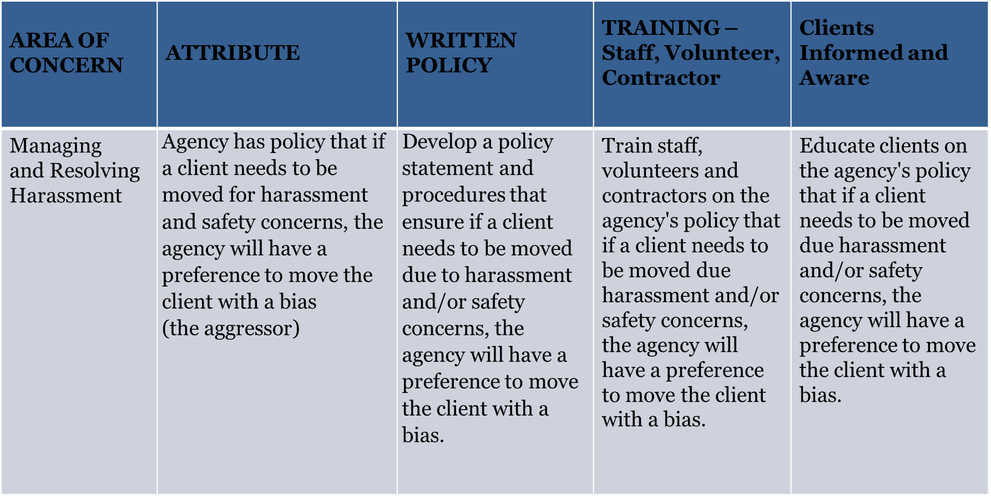
Detailed Example
Notes:
This example addresses complaints from clients who are uncomfortable with people whose gender identity is not ‘traditional’
NOTE That the rule applies to everyone interacting with the client within the organization – including volunteers and contractors
This example looks at Harassment Policy

Slide 19
Equal Access Decision Tool
Gives concrete examples of behaviors that either encourage or discourage equal access
Has an easy-to read format
Walks through each phase of the process
Outreach & Engagement
Assessment
Referral
Program Enrollment
Assignment to housing unit / bed
Offering On-going services and supports
Notes:
THIS TOOL gives concrete examples of behaviors that either encourage or discourage equal access interactions.
Again, it offers concrete examples in an easy to follow format –
This time, the tools is organized by the Processes

Slide 20
“In Your Pocket Guide
Engage respectfully
Empower all – Consumer choice and perspective
Inform everyone – Staff, volunteers, contactors, clients, constituents
Identity starts with “I” (the client) – the Individual customer’s perspective
No involuntary separation (also in CES guide)
Manage harassment and conflict – focus on aggressor; do not further isolate those who are marginalized, targeted
Notes:
Feeling a bit overwhelmed by details and small font?
Before we look at the next tool we offer a basic guide that should ‘travel with staff’ …and be established in agency POLICY

Slide 21











Supporting Equal Access Across the Full Spectrum of Services
Encouraging Discouraging
A staff person accepting the name and gender given by the potential client.
The staff person uses the pronoun as indicated by the client. This allows the person to feel more comfortable and continue in the outreach and engagement process.
If ID is required and the gender marker does not correspond to the client’s current gender ex- pression, the staff person uses the current gender expression as indicated by the client.
Outreach/Engagement
A staff person rejecting the client’s name or gender based on assumptions of the person’s name or sex-at-birth.
Using the incorrect pronoun after the client has given their preference.
Asking probing questions not necessary for engaging the individual. The individual may feel unsafe and choose to leave before outreach/engagement is complete.
If the person is feeling respected, they may give important information not included in the assessment that will assist in finding the right services for the individual. For example, based on the interaction, the staff may be able to recommend services to change the individuals ID along with risks and benefits.
A staff person accepts and uses the client’s preferred name and gender pro- noun regardless institutional documents or sex-assigned at birth. This allows the client to feel more comfortable and complete the assessment process.
Assessment
A staff person rejecting the client’s name or gender based on assumptions of the person’s name or sex-at-birth.
Using incorrect pronoun
after the client has given their preference.
Asking probing question regarding medications and medical procedures. If the individual feels harassed or violated by the staff or the process, the individual may abandon the assessment process and lose access to critical and potentially life saving services.
When referring a client to a single-sex or sex segregated project, the staff person offers to assist the client to ensure they are able to access services for which they are eligible. If the project rejects the client based on gender expression, the staff person reports the violation to the CoC while continuing to work with the client.
Making the connection to the referral project and only sharing information that the client has approved.
Listening to and respecting the client’s assessment of what feels safe to them when determining the referral options.
Referral
A staff person only makes re- ferrals to projects that the staff thinks will accept the client due to inappropriately perceived barriers.
A staff person does not follow-up with the receiving agency to make sure they are not discriminating against the client and turning them away.
A staff person provides information to the receiving project that discloses the client’s transgender status without the client’s consent.
Providing a confidential area to describe services that the client may want to access to ensure the client’s confidentiality.
The staff does not ask about the client’s sex assigned at birth during the intake process.
A staff person at a project that segregates services based on gender accepts the client whose gender expression does not
fit the stereotypical gender expression.
A staff person at a project that segregates services based on gender accepts the client who identifies with that gender.
Enrollment
A staff person turning away a potential client based on their gender expression.
A staff person treating a client in a way that violates the individual’s confidentiality around gender expression
A staff person does not respect the client’s assessment of their safety and tries to encourage them to go to a shelter that will make them “more comfortable” based on the staff person’s perceptions.
A staff person quickly resolves conflicts severe enough to warrant the expulsion of a harassing client.
Staff model appropriate respect and coach clients that express verbal and non-verbal disrespect.
Staff provide confidential space to allow clients to discuss issues related to harassment or other concerns connected to their current gender expression within the project.
Unit/Bed Assignment
A staff person ignores reasonable requests for accommodation in bed assignments based on a client’s health and safety concerns.
A staff person moves the gender non-conforming client when conflict arises based on the client’s gender identity.
The agency does not have bath- rooms and showers arranged to provide privacy.
Staff move the more compliant client when conflict arises even if that client was the subject of harassment.
A staff person recognizes the client’s right to access all services for which they are eligible.
Upon complaint, staff correct and engage clients’ misper- ception that gender expression creates a safety risk.
A staff person promotes
non-discrimination by ensuring all clients understand that verbal and physical bullying are not allowed.
Ongoing Service Provision
A staff person does not take a transgender client’s safety concerns seriously and fails to address them.
A staff person reassigns a trans- gender client’s bed based on another client’s complaint related solely to gender expression.
A staff person fails to intervene when a client is harassing someone based on their gender expression.
Notes:
ACKNOWLEDGE HUD CPD for the Decision- Making tool
AGAIN the font is too small for you to see – so let’s choose pieces as examples:

Slide 22
Examples at Intake
ENCOURAGING
When identification is required and the gender designation doesn’t ‘match’ what the client states,
the worker accepts and uses the identification expressed by the client.
DISCOURAGING
The worker states that the identification indicates a specific gender, asks probing questions “to resolve the conflicting information” or informs the client that they will need to record the ‘correct’ information in the official case file.
Notes:
Behaviors, language, attitude at each step of the process can either support and encourage or violate and discourage equal access.

Slide 23
Agency Personnel Self-Check
Frontline staff:
Do you have an anti-discrimination policy?
Is it posted publicly? No? Get a notice of rights at: https://www.hudexchange.info/resources/documents/Notice-on-Equal-Access- Rights.pdf
Managers and Directors:
  Do you have an anti-discrimination policy?
  Do you regularly train staff and volunteers on the policy and how to implement? (Hint: use the staff training scenarios to get started!)
CoC Boards and other planning bodies:
  Do your projects have anti-discrimination policies?
  Do your support projects to train staff on the policy and how to implement it?
  Have we been clear that projects must comply with these requirements?
Notes:
Which role do you play m your organization?
Ask yourself the questions under that role.
If you cannot clearly say YES you need to take corrective action!

Slide 24
Example at the Referral Stage
ENCOURAGING
When referring client for housing or services, staff:
Listen to and respect the client’s assessment of what feels safe to them when determining the referral options.
Provides an array of options for consideration.
DISCOURAGING
  A staff person disagrees with the client’s assessment of their safety and tries to encourage them to go to a shelter that will make them “more comfortable” based on the staff person’s perceptions.
Staff does not follow up after referral to ensure secure placement.
Notes:
Another example – this one is at the time of referral
(Read each example)

Slide 25
Intake/Screening for Gender
INTAKE or SCREENING QUESTIONS
Legal Name:
Preferred Name:
What is your gender identity? (Check and/or circle ALL that apply)
Male
Female
Transgender Male/Transman/FTM
Transgender Female/Transwoman/MTF
Non-Binary Identity
Do not identify as Male, Female or Transgender
Culturally Identified gender, such as Two-Spirit or Berdache
Additional category (please specify):
Prefer to not answer
4. What pronouns do you use?
5. How would you like to be addressed? (nickname, first name, title and last name, other)
Notes:
There are many ways that help people feel welcomed or recognized
Begin by supporting empowerment and self-determination of the person requesting assistance.
In addition to formal name and preferred name, recognize that there are many terms and concepts for gender --- including some tied to culture/ race/ethnicity – like two-spirit or berdache
In addition to gathering the ‘data’ ask how the person wishes to be addressed ---

Slide 26
Examples and Tools Help Achieve Goals
Strengthen policies and services to improve the housing outcomes for people experiencing homelessness across your crisis response system.
Implement an equal access approach that includes emergency shelters.
Align Actions with the community’s goals to promote equal Access.
Provide low-barrier, safe, and client-focused resources.
https://endhomelessness.org/resource/emergency-shelter

Slide 27

Example #1
If I operate a project using HUD funds that serves single women and children, do I need to serve men with children?
❑ Yes
❑ No
Notes:
Example # 1 is a A common question

Slide 28

Example #1 Answer
HUD SAYS – YES!
HUD funded projects that serve families with minor children are not permitted to exclude families based on the gender of the head-of-household.
A household with a head-of-household who is male, and otherwise eligible for the service, must be provided access to the same services, opportunities, and staff to which all households enrolled in the project have access.
Projects may establish a requirement that they only serve households with minor children and exclude households comprised entirely of adults.

Slide 29

Example #2
You operate a small facility w only two restrooms with showers.
A transgender client asks which restroom they should use.
Another client overhears the conversation, a becomes upset, expresses fear that the client will be ‘spying’ on them
What do you say?
What can you do?

Slide 30
Example #2 - Answer
Assure both clients that you want to help them to be able to shower comfortably.
Because access is based on self-declared gender identity – ask which shower would be more comfortable.
Offer the upset client a chance to shower privately later.
Increase privacy, when possible, by:
Installing temporary or permanent curtains
Installing locks, doors, or partitions to toilet stalls
Create staggered shower schedules for everyone to ensure access and to enhance privacy
Expand Access: Make single-use facilities all-gender, meaning anyone can use them
Notes:
Need to ensure ALL people feel supported / have access
Emphasize desire for everyone to the comfortable
Ask their opinion about what would be most comfortable
Create structures/opportunities to prevent or to remedy issues
Note: if you create schedules you CANNOT institute processes that are discriminatory – for example, the schedule could not call for all persons in a protected class to get up and shower at 4:30 AM – or only use the restroom during one hour during the day.

Slide 31
Example #3
A 50 bed men’s shelter in an old building with only congregate sleeping and bathroom facilities, with virtually no client privacy. One of the guests comes to a volunteer staff persons and identifies himself as transgender.
Do I allow them to stay in the main sleeping quarters?
Do I have to provide them with a special sleeping arrangement if they request one?

Slide 32
Example #3 Answer
Not only can you allow him to stay in the main room but you are required to.
Do not isolate clients based on their transgender status.
A client may request an accommodation (in this case perhaps requesting a bed assignment near the staff workstation or
Access to space set aside for highly vulnerable clients) however, staff may not impose or require a client accept an accommodation.
Treat all clients who are eligible, in this case anyone identifying as male, with the same services, staff, questions, and setting that all other clients receive.

Slide 33
Examples - Discrimination
Transgender:
Umbrella term for people whose gender identity is different from their assigned sex.
Occasionally, an individual may determine they no longer identify as
transgender after they transition.
CANNOT continue to refer to the person as transgendered.
Transitioning (Gender Transition):
Process that some (but not all) transgender people go through to begin living as the gender with which they identify, rather than the sex assigned to them at birth.
Transitioning does not require medical treatment.
CANNOT ask when they will have surgery, or what was wrong with the birth gender.
Notes:
WHAT about Examples of Discrimination?

Slide 34
Examples - Discrimination
A coordinated entry call center tell the caller that there is nothing available for a person like them or hangs up when a caller identifies as transgender.
A shelter worker inquiring about an individual’s anatomy prior to enrolling them.
A site manager who enforces project rules differently for single-father households than for single-mother households.
A family shelter that requires boys over the age of 13 to move out.
A project staff person refusing to enroll an eligible individual because “you will make the other residents uncomfortable.”

Slide 35

Public Posting
Make all constituents aware –
Staff
Volunteers
Contractors
Clients
Community Members
Publicly Post Notice
https://www.hud.gov/sites/documents/LGBTFLYER.PDF

Slide 36
Create Cultural Awareness - Terms
Gender Identity
Internal or innate sense of being male, female, or another gender
May or may not match their assigned sex at birth
Gender Expression:
External expression of gender identity (note that many times people do not feel they can safely express their gender identity)
Exhibited through behavior, clothing, hairstyle, body language, and voice
Sexual Orientation:
Physical or emotional attraction to the same and/or opposite sex
Distinct from one’s gender expression or identity

Slide 37
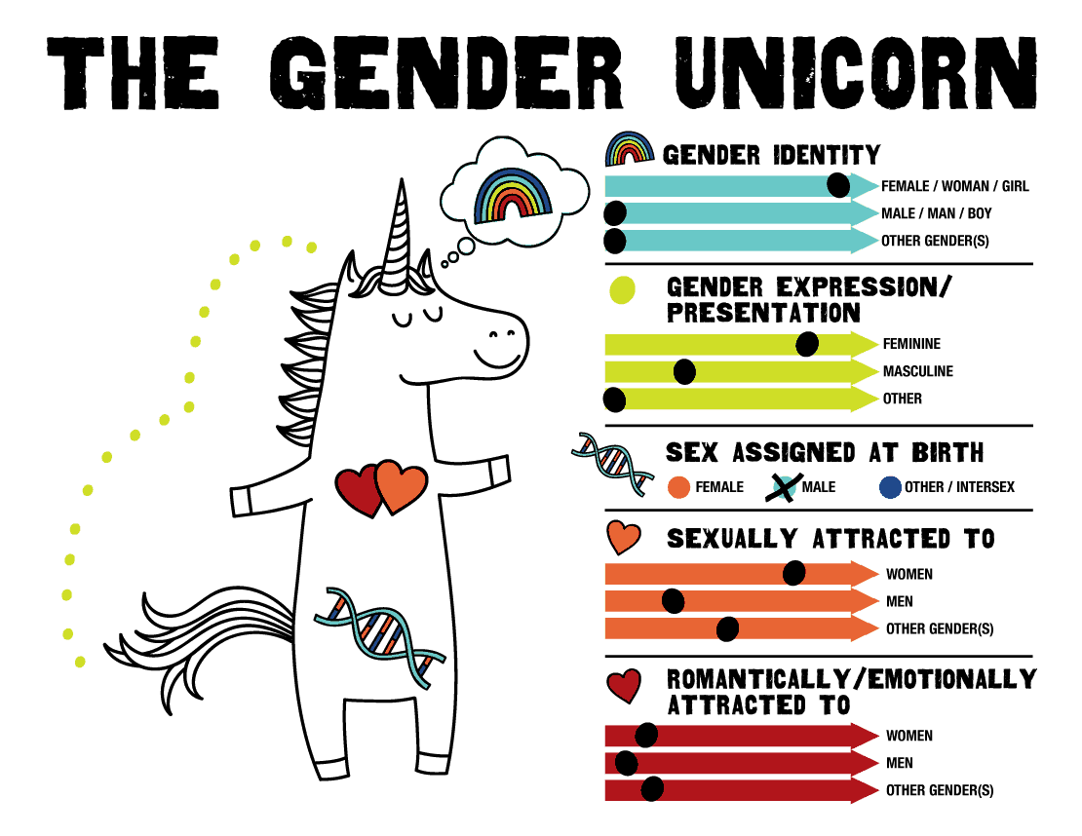
Notes:
SO what is Gender Identity?
Gender Identity:
Internal or innate sense of being male, female, or another gender
May or may not match their assigned sex at birth
Gender Expression:
External expression of gender identity (note that many times people do not feel they can safely express their gender identity)
Exhibited through: behavior, clothing, hairstyle, body language, and voice
Sexual Orientation:
Physical or emotional attraction to the same and/or opposite sex
Distinct from one’s gender expression or identity

Slide 38
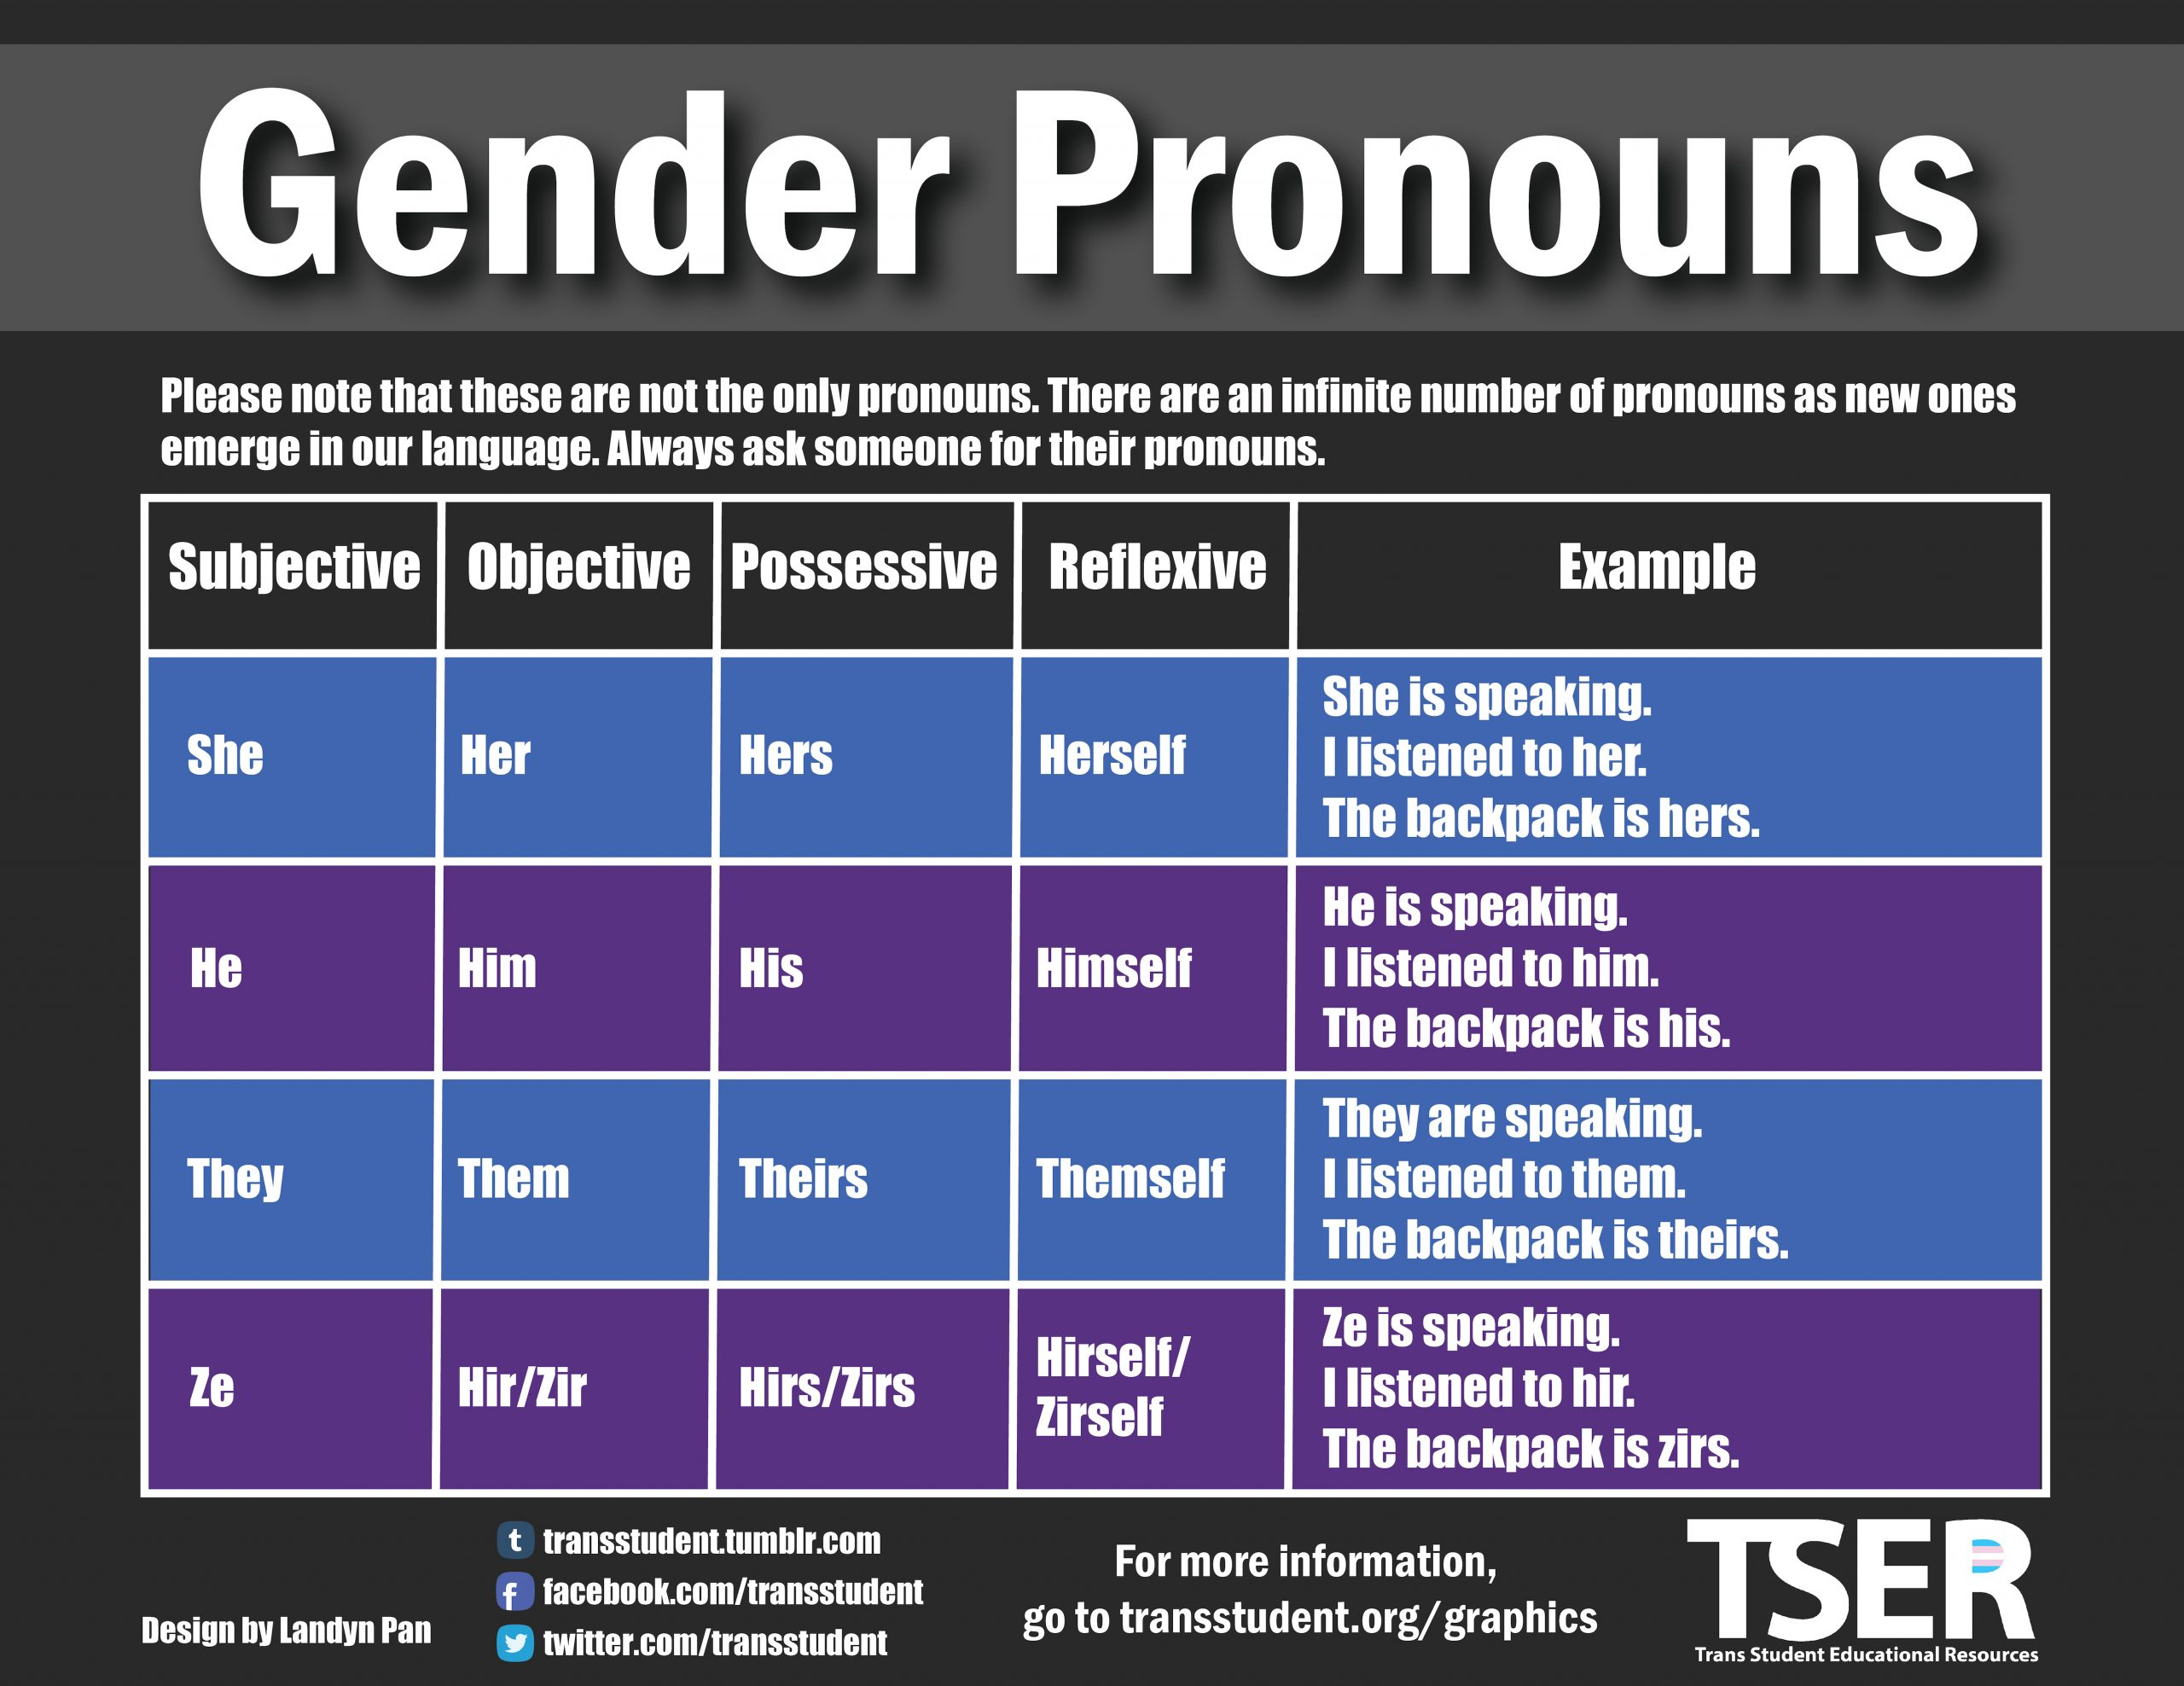
Help Create Culturally Comfortable Space

Slide 39
Check List
Agency policy references Equal Access
Policies clearly identity protections.
Procedures are in place to guide resolution of conflicts. (Give sample responses in training.)
Written and on-line materials reflect gender awareness
Public postings inform everyone of agency commitment to protecting consumer rights
Notes:
Simple checklist to accompany the use of tools.
Remember the “in your pocket” guide – reinforce in policies and training.
These help support equal access

Slide 40
Check List, continued
Regular training is provided when new staff, volunteers, or contractors join the organization
Use scenarios to assess staff/volunteer understanding (test) of policies and protocols.
Consumer feedback/file reviews/ and staff evaluations confirm implementation as a priority.
Notes:
Simple checklist to accompany the use of tools.
Remember the “in your pocket” guide – reinforce in policies and training.
These help support equal access

Slide 41
Other Tips that Support EQ Compliance
Housing First Fidelity
HUD Monitoring: File Maintenance: Eligibility; Policy
  Non-Discrimination: Furthering Equity, Policies and Practices
  Performance Improvement Plans for Areas found to be Problematic

Slide 42
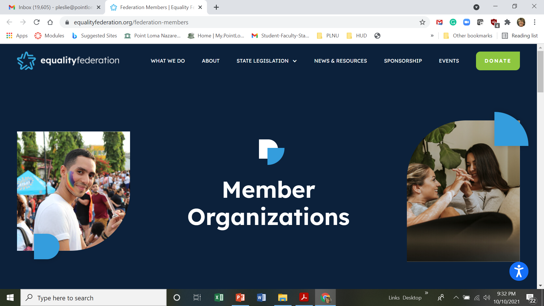
State-Wide Resource - Advocacy

Slide 43

QUESTIONS?
Thank you!
Dr. Pat Leslie, PhD pleslie@pointloma.edu
Dr. Deme Hill, DPA hilldeme@yahoo.com

